Slide 1
HR ANALYST PROJECT
2024
ON EXCEL, POWER BI, TABLEAU AND SQL

Slide 2
PROJECT ON EMPLOYEE RENTENTION
2024
EMPLOYEE RETENTION ON PROJECT
We performed an analysis on HR data for employee retention having 50,000+ records and drawn KPI from it using excel, my SQL and also used visualization tools like tableau and also used power bi to make dynamic dashboard.
We got some insights regarding attrition of employees with respect to department, monthly income, work life balance, years of promotion etc.
USING :
MS EXCEL, MYSQL, POWERBI AND TABLEAU

Slide 3
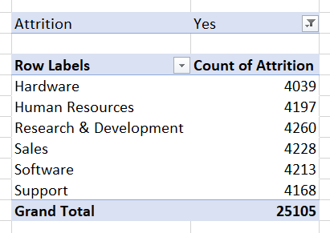
Average Attrition Rate for All Departments
20XX
Use a Pivot Table:
Rows: Department Values: Count of employees (filter by "Attrition = Yes").{=COUNTIF(B:B,”YES”)}
Calculate the percentage of attrition for each department
Count of Attrition / Total of Attrition *100

Slide 4
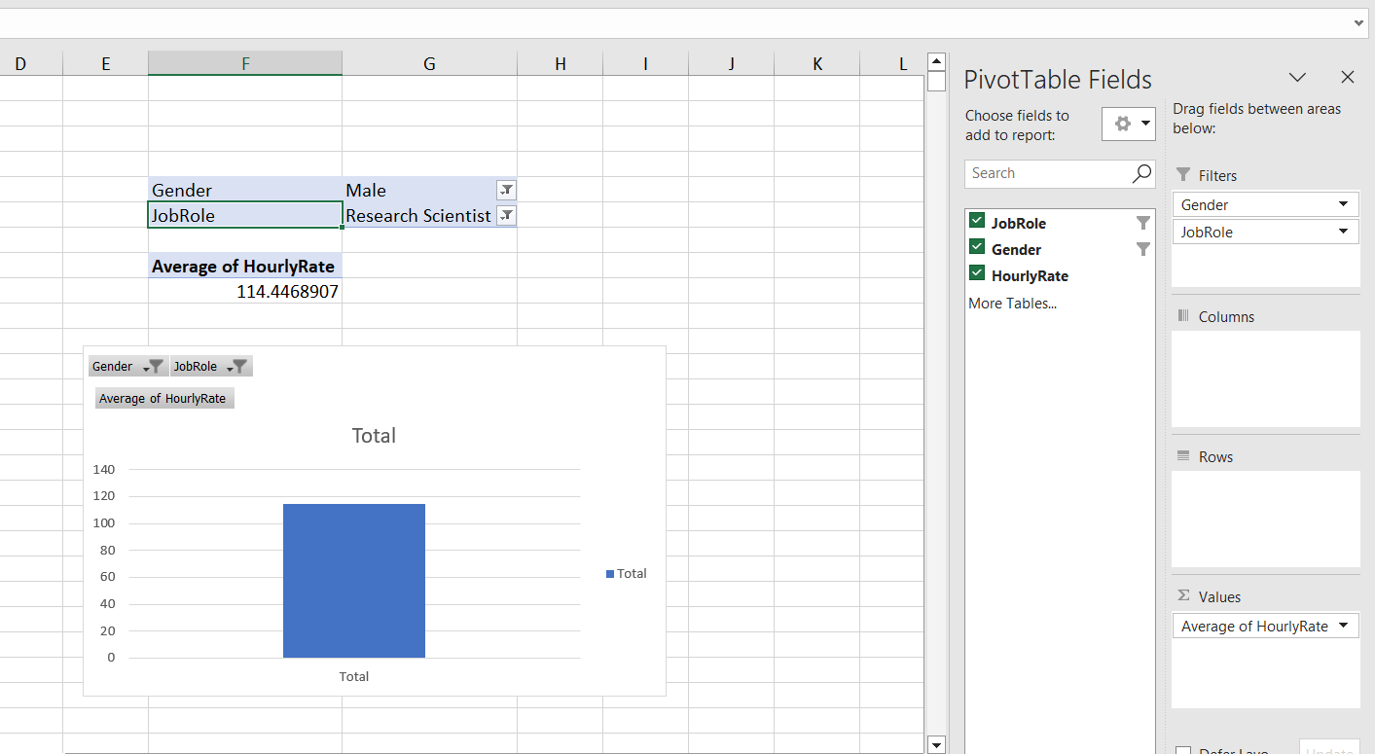
Average Hourly rate of Male Research Scientist
20XX
Filter by Gender = Male and Job Role = Research Scientist.
Use the AVERAGE() function to calculate the average hourly rate.

Slide 5
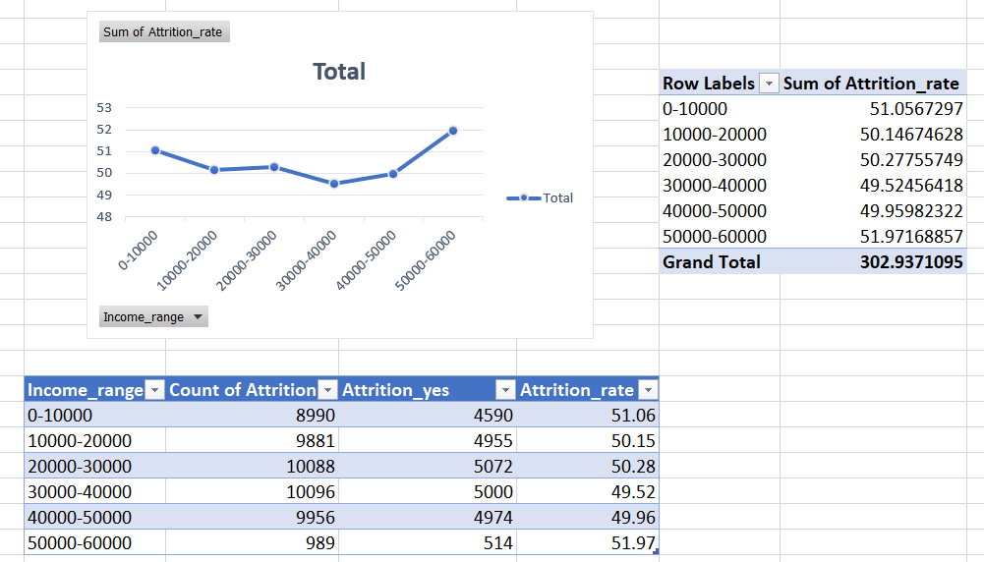
Attrition rate Vs Monthly income stats
20XX
X-axis : Monthly income
Y-axis : Attrition rate

Slide 6
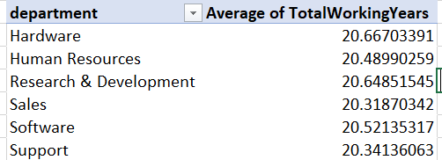
Average working years for each Department
20XX
Rows: Department
Values : Average of Years working

Slide 7
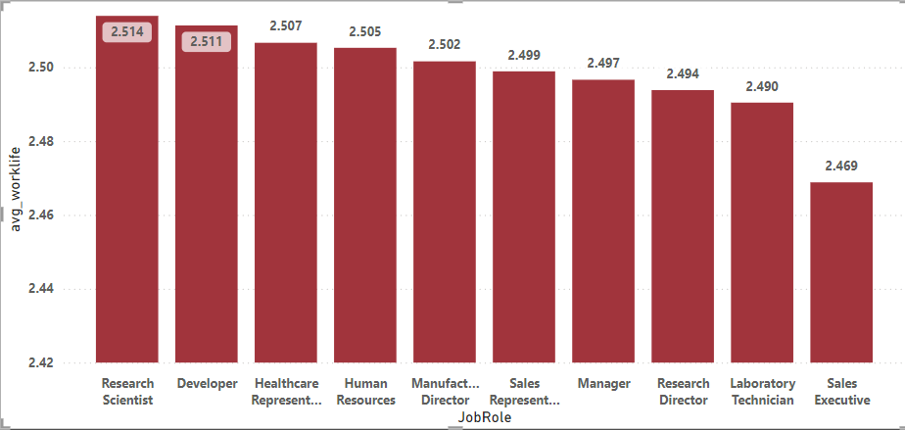
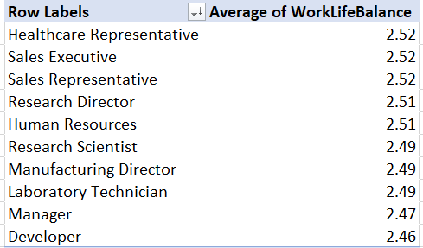
Job Role Vs Work life balance
20XX
Rows: Job Role
Values: Average of work-life Balance Rating

Slide 8
Attrition rate vs Year last promations
20XX
X-axis : Years since last promotion.
Values: Attrition rate

Slide 9
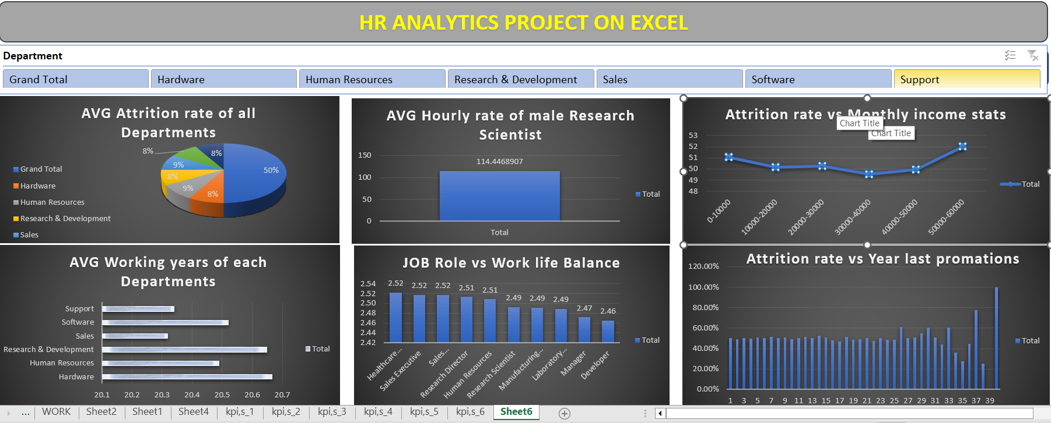

PICTURE SLIDE
20XX
EXCEL

Slide 10
THANK YOU!
2024

